Slide 1
VASOPRESSOR DRUGS
IN TREATMENT OF SHOCKS
Vu Minh Phuc MD. PhD.

Slide 2
Vasopressor drugs are used
in the following cases:
        Anaphylactic shock
        Septic shock
        Neurogenic shock
        Cardiogenic shock

Slide 3
Vasopressor drugs
 | Dobu-tamine β₁>β₂>α | Dopamine Dopa>β High dose α | Ephe-drine β₁>α | Epine-phrine β₁= β₂> α | Norepi-nephrine β₁>α> β₂ | Isopro-terenol β₁>β₂ | Milrinone PDE inhitor | Phenyl-ephrine α agonist
Dose μg/kg/min | 2-15 | 2-5 (renal +) 5-10 (inotrope +) 10-20(SVR+) | 5-25 mg q 10 min (adult) | 0.01-0.03 max 0.1-0.3 | 0.01-0.03 max 0.1 | 0.01-0.1 | Load in 10 min 50μg/kg, 0.375-0.75 | 0.2-0.3
T1/2, min | 2.4 | 2 |  | 2 | 3 | 2 | 150 | 20
Inotrope | ++ | ++ | ++ | +++ | + | +++ | + | 0
Ateriolar vasodilation | + | ++ | 0 | + | 0 | + | ++ | -
Vaso- constriction | High dose + | High dose ++ | 0 or + | High dose + | ++ | 0 | 0 | +++
Chronotrope | + | 0 or + | ++ | ++ | + | +++ | 0 | 0
BP SVR | + - | High dose + High dose + | + + | 0 or + - or 0 or + | + +++ | + - | - - - | +++ +++
Cardiac output | ++ | + | ++ | ++ | ++ | ++ | + | 0 or -
Diuretic effect | 0 | ++ | 0 | 0 | + | 0 | 0 | -
Arrhythmia | ++ | High dose + |  | +++ | + | +++ | + | 0
Comment | Tachycardia > Dopa | Usefullness in renal failure | Short-term use only | - Low - β - High - α Tachycardia < Dobu | Particular-ly useful with milrinone | Usefull in bradycardia | ↓ PVR useful in RV failure | Used in high CO with low BP

Slide 4
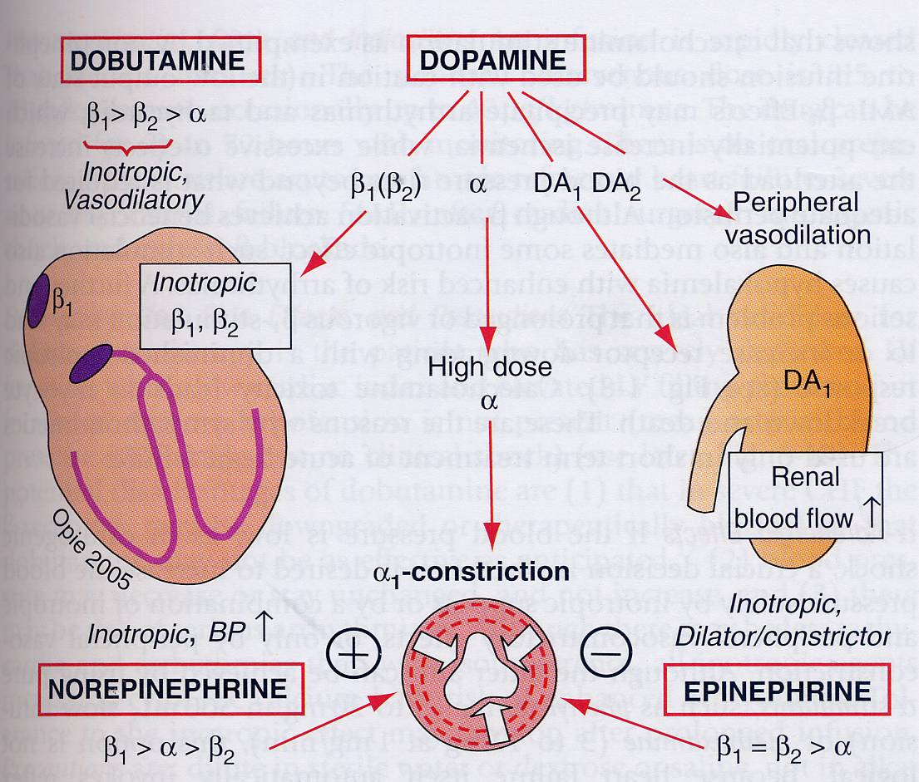

Slide 5
SEPTIC SHOCK

Slide 6
    Bacteremia to sepsis to the SIRS
FOCAL INFECTION
BACTERIA
BACTEREMIA
Clinical evidence of infection plus :
Hyper-hypothermia
Tachycardia
Tachypnea
WBC abnormalities
Sepsis plus at least 1 of the following:
Acute mental changes
Hypoxemia
Plasma lactate
Oliguria
SEPSIS
SEPSIS syndrome
EARLY SEPTIC SHOCK
Sepsis syndrome plus:
↓ BP or poor capillary refill that responds promptly to IV fluids and/or
Pharmacologic intervention
Sepsis syndrome plus:
↓ BP or poor capillary refill
that lasts for > 1 hour
despiite IV fluids & phar-
macologic intervention
and requires vasopressor support
REFRACTORY
SEPTIC SHOCK
Any combination of:
DIC
ARDS
Acute renal or heart failue
Acute hepatic failure
Acute CNS dysfuntion
MODs
DEATH

Slide 7
    Pathophysiology of septic shock
FOCUS OF INFECTION
BACTERIAL CELL WALL PRODUCTS
ACTH/ENDORPHINE PRIMARY MEDIATORS
RELEASE (TNF, IL-1, IFN, OTHERS)
COAGULATION ENDOTHELIAL/LEUKOCYTE COMPLEMENT
SYSTEMIC MOLECULAR ACTIVATION SYSTEMIC
ACTIVATION ACTIVATION
KALLIKREIN- SECONDARY MEDIATORS PMN
KININ (PAF, EICOSANOIDS, STIMULATION
STIMULATION OTHER INTERLEUKINS,..)
VASODILATION SHOCK CAPILLARY LEAK
ENDOTHELIAL ENDOTHELIAL
DAMGE MODS DAMAGE
DEATH
* Dopamine (high dose)
* Norepinephrine
* Thêm Dobutamine or Milrinone
Fluids infusion

Slide 8
    Multiorgan damage (MOD)
      ALS (acute lung syndrome), ARDS (acute respiratory distress syndrome)
      Myocarditis, myocardial cell necrosis
        Heart failure:
        - edema, oliguria, cough, dyspnea
        - pale, hypotension, tachypnea, tachycardia, gallop,
        rales, hepatomegaly, CVP ↑
        - CXR: cardiomegaly
        Echocardiography: cardiomegaly, SF, EF ↓
        ECG: tachycardia, arrythmias, ST-T changes
        Cardiogenic shock: heart failure + shock
        Arrythmias : APBs, VPBs, VT, SVT, Block, …
      Brain damage
      Hepatic failure, gastrointestinal hemorrhage
      Adrenal failure, Renal failure
      DIC

Slide 9
Indication of vasopressor drugs
  Vasodilation by endothelial damage
    ↓ BP or poor capillary refill lasts for >1 hour despite IV fluids & pharmacologic intervention
    ↓ BP or poor capillary refill + DIC
     Despite values of CVP (low, normal or high)
    - At first, give dopamine 5-20 μg/kg/min
    - No effect with dopamine
      norepinephrine: 0,01-0,4 μg/kg/min and
      attemp wean dopamine to renal dose

Slide 10
Indication of vasopressor drugs
  Heart damage in MOD
    Shock with dangerous low BP
      Norepineprine + Dopamine (renal dose)
      Norepinephrine + Dobutamine + Dopamine (renal dose)
    Shock with low BP
      Dobutamine + Dopamine (renal dose)
    Shock with normal BP
      Dobutamine or
      Milrinone

Slide 11
NEUROGENIC SHOCK

Slide 12
        Central Nervous System
        - Infection
        - Inflammation
        - Intoxication
        - Trauma + Hemorrhagy
        - Tumor
        - Metabolism diseases
Cerebral Hypoxia
Cerebral oedema
Dysfunction of premotor & motor autonomic centers
Vasodilation
Shock
Dopamine or
Norepinephrine
Fluid transfusion
depends on CVP

Slide 13
CARDIOGENIC SHOCK

Slide 14
Causes
  Myocardial Infarction (LV, RV)
  Myocarditis
  Myocardiopathy
  Acute VSD
  Arrhythmias/heart block
  Severe chronic heart failure (many causes)
  Cardiac tamponade
Cardiac output (CO) = Stroke volume × heart rate
Cardiac index (CI) = CO/ m² BSA
Cardiogenic shock = CI < 2.5 L/ min/ m² BSA
Low BP (shock)
  BP ≤ 90/50 mmHg (children and adults)
  BPs ≤ 70 + 2n (> 12 months)
  BP ≤ 5th normal BP (< 12 months)
Dangerous low BP (damage important organs)
  BPs < 70 mmHg (children)
  BP ≤ 10th normal BP

Slide 15
Categories of cardiogenic shock
 | Preload | Contractility | Afterload
Parameter measured | CVP RAP PCWP | SF EF | Capillary refill BP
Abnormal manifestation | - Low CVP, or PCWP - Low CO - Low BP | - High CVP or PCWP - Low CO - Low BP | - High CVP or PCWP - Low CO - Normal BP
Treatment to improve CO | Volume expansion - crystalloid - colloids - whole blood | Positive inotrope Norepi, epi Dopa, Dobu Milrinone Isoproterenol | Vasodilation - Nitroglycerin - Nitroprusside - Dobutamine - Milrinone
CVP = central venous pressure RAP = right atrial pressure
PCWP = pulmonary capillary wedge pressure

Slide 16
    Vasoactive drugs when CI < 2.5 L/min/m²
  sBP ≤ 90 mmHg (70+2n) sBP > 90 mmHg (70+2n)
  (↓ preload, ↓ contractility) (↑ afterload)
  PCWP < 15mmHg PCPW > 15mmHg PCPW < 15mmHg
  RAP < 5mmHg RAP > 10mmHg RAP > 10mmHg
  CVP < 10cm H₂O CVP > 10cm H₂O CVP > 10cm H₂O LV failure
  Hypovolemia Exclude acute MR, Exclude cardiac ↓ afterload
  (↓ preload ) acuteVSD, cardiac tamponade, pul- - Nitroglycerin/
  tamponade monary embolism - Nitroprusside
  until sBP = 100
  Fluid challenge ↓ contractility of LV ↓ contractility of RV
  If sBP ≤ 60mmHg If sBP > 60mmHg Volume infusion If CI still low
  - Norepinephrine and/or - Dobutamine and until sBP > 90, Add dobutamin
  - Dopamin (10-20μg/kg/min) - Renal dose PCPW > 20, or milrinone
  Once sBP > 60mmHg Dopamine RAP > 20 If hypotension
  - Add dobutamine Dobutamin subtitute
  - discontinue norepinephrine preffered than dopamine for
  - ↓ dopamine to renal dose dopamine dobutamin

Slide 17


